Slide 1
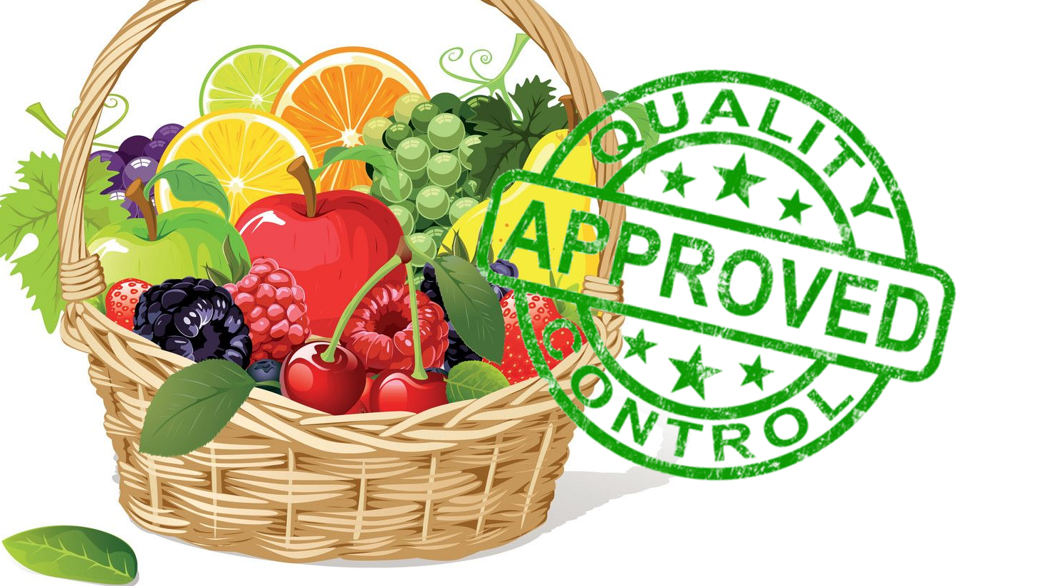
Qualiफल
Computer Vision Based Fruit Quality Assurance

Slide 2
Introduction
Fruit exports in India amounted to nearly 764 million US dollars in the fiscal year 2020.
Keep up with the quality standards of the fruits being exported
Increase in online doorstep delivery of fruits and vegetables Covid-19
The food industry needs to keep up with the quality of delivered fruits and vegetables
Ensure fresh fruits are reaching the consumers from the farms, wholesale markets/mandis Eliminate fruits that undergo deterioration during any stage of the supply chain.

Slide 3
Motivation
Quality management of fruits and vegetables is very much needed to deliver quality fruits guaranteed to the end consumer.
The traditional techniques are arduous and labor intensive as they require manual inspection process which is subjective in nature and requires gradual migration to being replaced by more artificially intelligent techniques.
Also based on initial assessment of quality, we can determine which all fruits must be supplied first out of the wholesale storage and silos before quality becomes even lower and eventually leading in wastage.

Slide 4
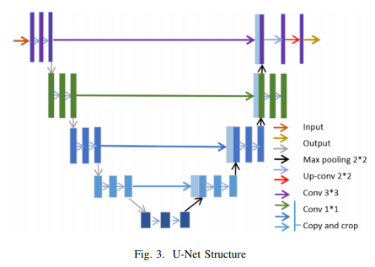
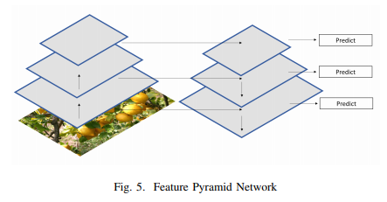
Model Architectures
The various architectures that
we have implemented are-
U-Net
FPN
Dilation Rate

Slide 5
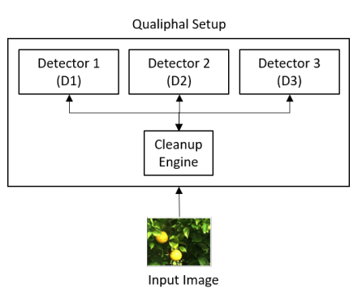
Application Architecture
Training Setup
Segmentation
Classification
Detection
Ensembled Detectors

Slide 6
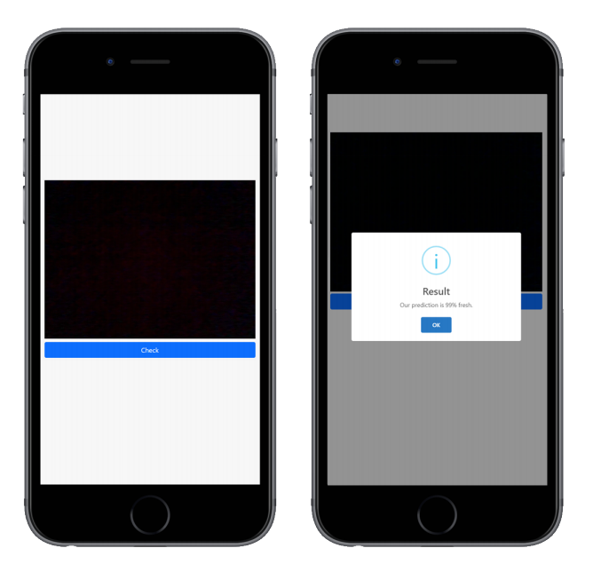
Ease of Accessibility and Scalabilty
One-stop-shop for farmers
If it is detects that the quality of the fruits are deteriorating, the fruit is sent to nearest drop
off point for immediate usage or consumption
If it is diseased, then alerted for disposal.

Slide 7
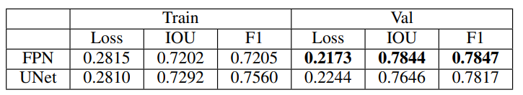
EXPERIMENTAL RESULTS

Slide 8
EXPERIMENTAL RESULTS
We observed that FPN performs slightly better than UNet on metrics - IoU score(Intersection over Union), F1 and loss.
Pyramid feature map enriched with lateral connections between bottom-up and top-down pathway gives better segmentation maps when tiny regions are to be segmented from the high resolution images as this is the case in our problem.
UNet on the other hand is not able to identify tiny smaller regions but performs excellent on relatively larger segmented portions of fruit.

Slide 9
Future Work
Study how the models work with different Backbones
Try out combinations of traditional methods applied before.
Experiment and work on Different datasets

Slide 10
